Slide 1
MSD
Hadoop Crashcourse
8. 9. 2015

Slide 2


WHO WE ARE
We are known as MSD. We are known as Merck in the United States and Canada.
RICH HISTORY
Operating since 1851
BUSINESSES
Pharmaceuticals, Vaccines, Biologics and Animal Health
Key Company Facts
2014 REVENUES
$42.2 billion; 61% of sales come from outside the United States
2014 R&D
EXPENSE
$6.5 billion; 25 drug candidates in late-stage development; key areas: oncology, CV, diabetes, respiratory & immunology, neurology, infectious disease and vaccines
HEADQUARTERS
Kenilworth, New Jersey, U.S.A.
EMPLOYEES
Approximately 70,000 worldwide (as of 12/31/14)
Notes:
2
No notes provided.

Slide 3
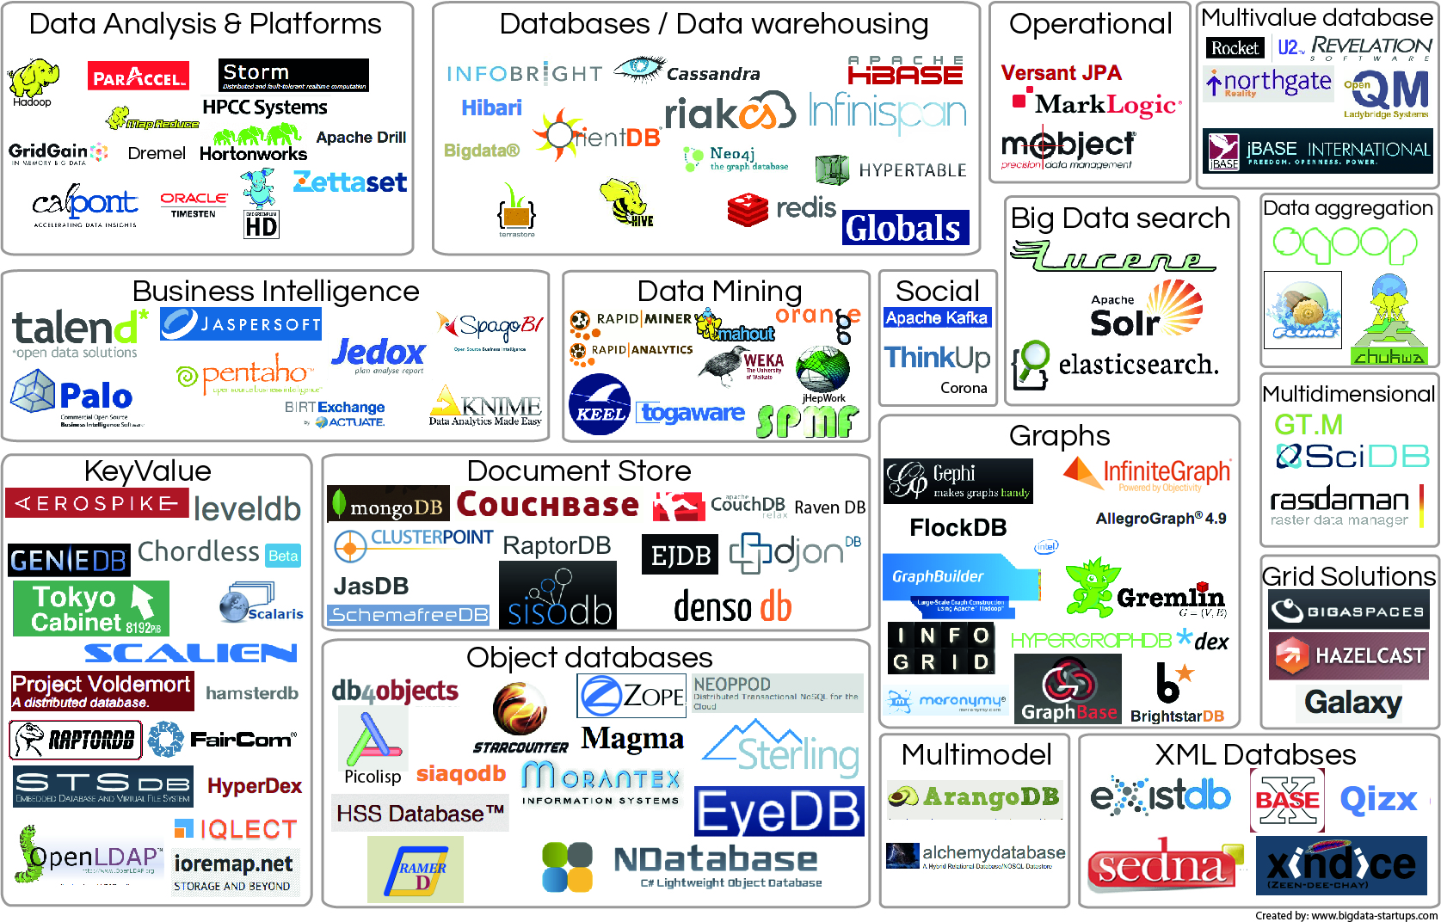

Slide 4

Instead of one powerful (and expensive) server…

Slide 5
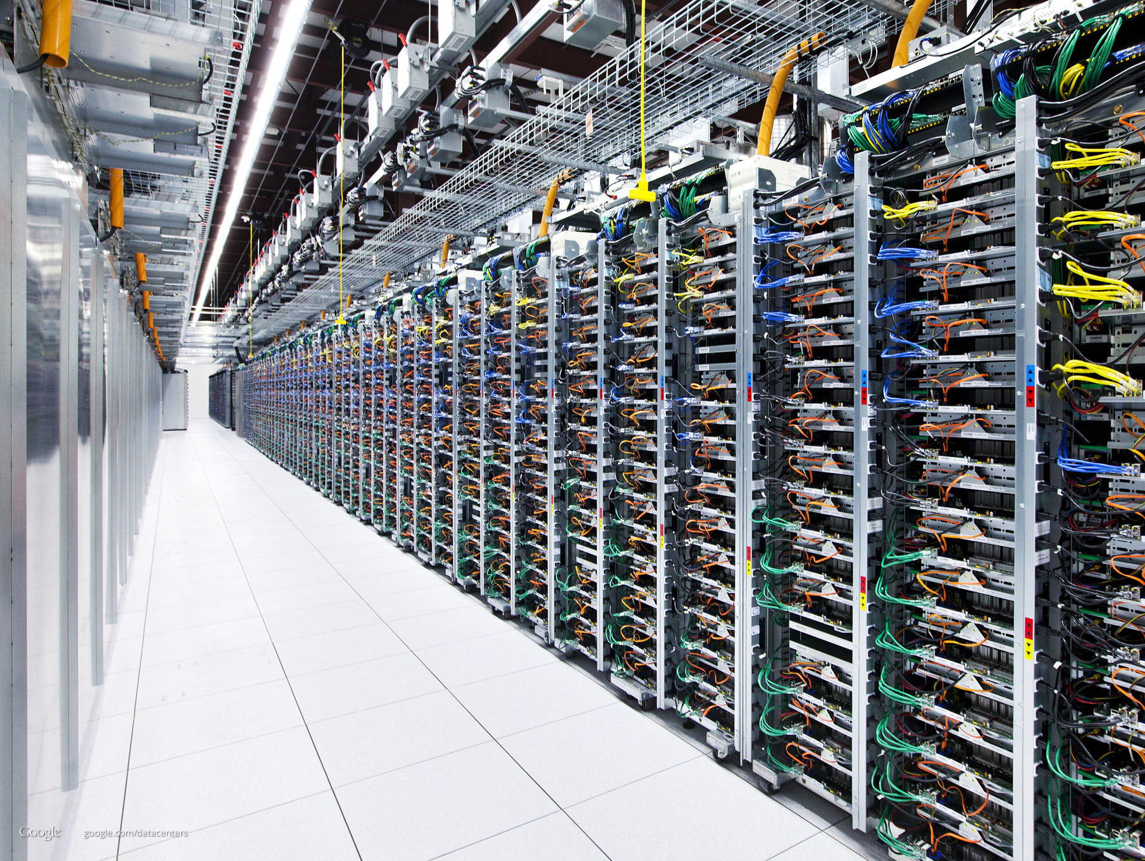
… use many low-cost servers in a cluster.
5

Slide 6
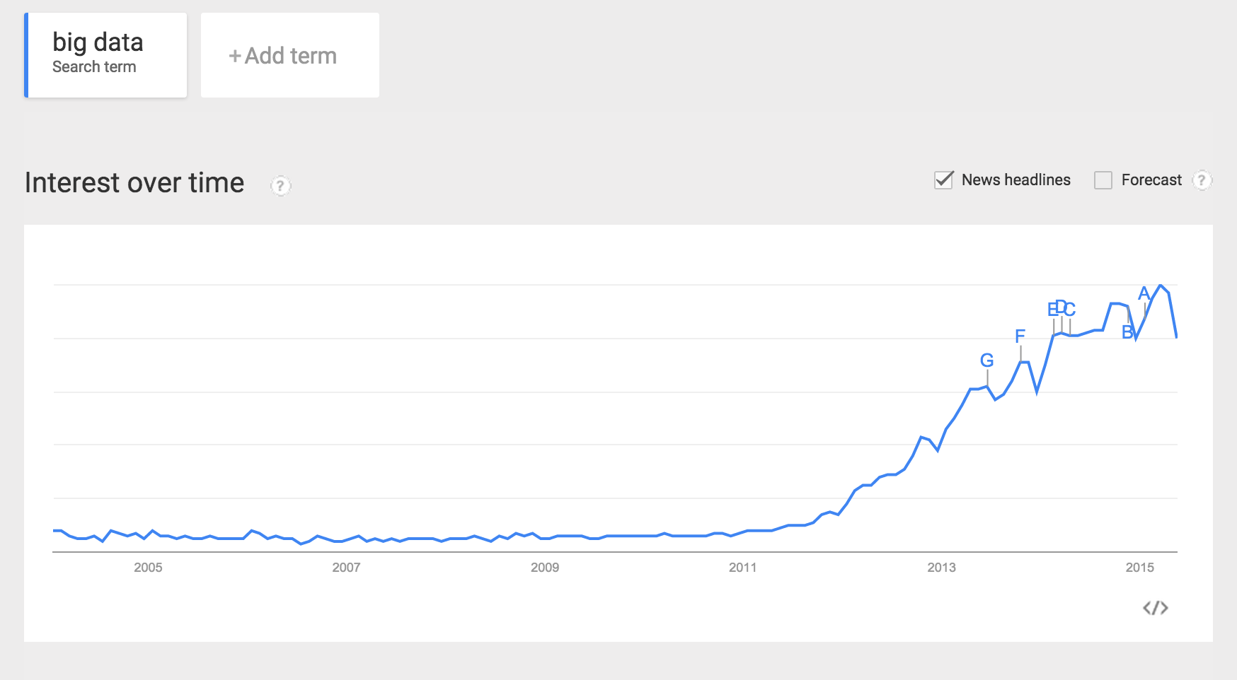
2003 Google FileSystem Paper Published
2011 Hortonworks founded
2009 Cloudera Distribution
2006 Google BigTable Paper
Hadoop 1.0 Released
2009 Hadoop available to public
2004 MapReduce Paper Published

Slide 7
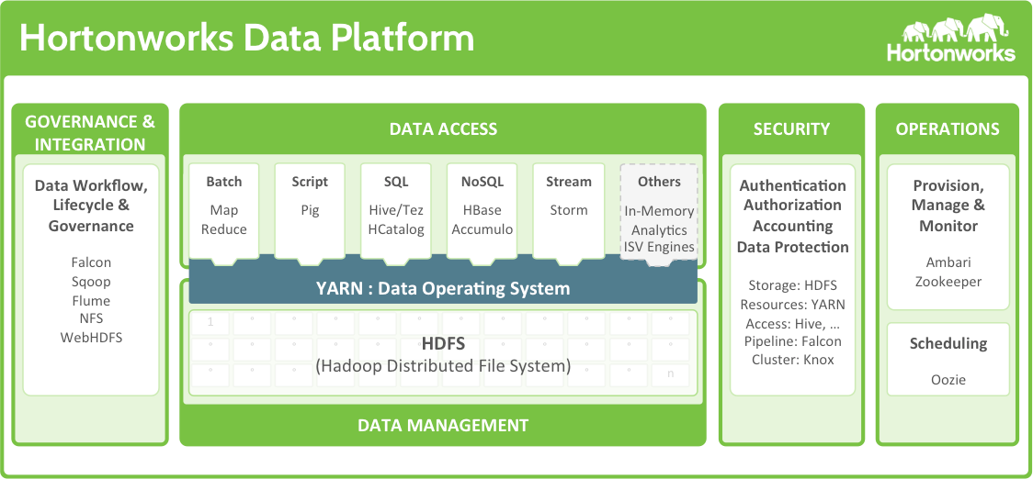

Slide 8
Basic Principles

Slide 9

http://static.googleusercontent.com/media/research.google.com/en//archive/gfs-sosp2003.pdf
Notes:
http://hadoop.apache.org/docs/r1.2.1/hdfs_design.html

Slide 10
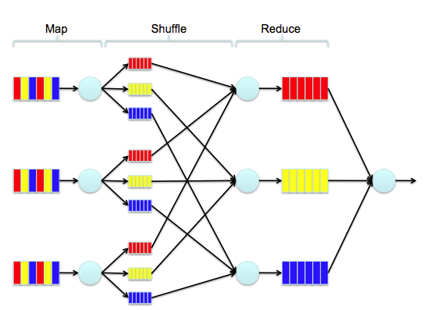
http://static.googleusercontent.com/media/research.google.com/es/us/archive/mapreduce-osdi04.pdf

Slide 11
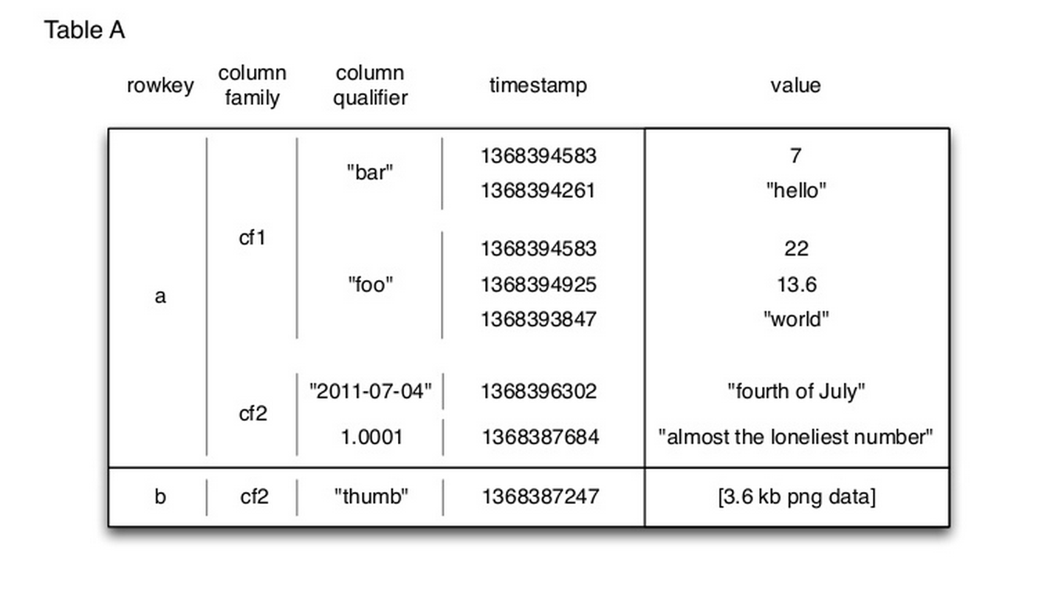
http://static.googleusercontent.com/media/research.google.com/cs//archive/bigtable-osdi06.pdf
Notes:
http://www.slideshare.net/xefyr/h-base-for-architectspptx?related=1

Slide 12
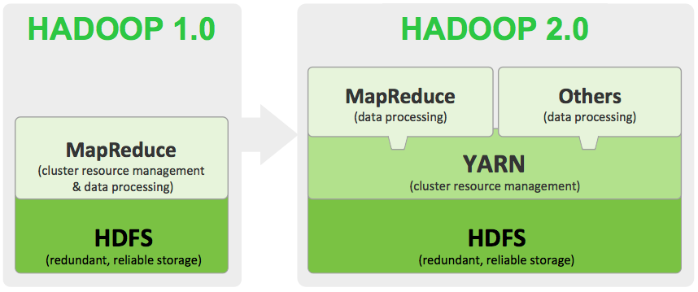
Notes:
2012

Slide 13
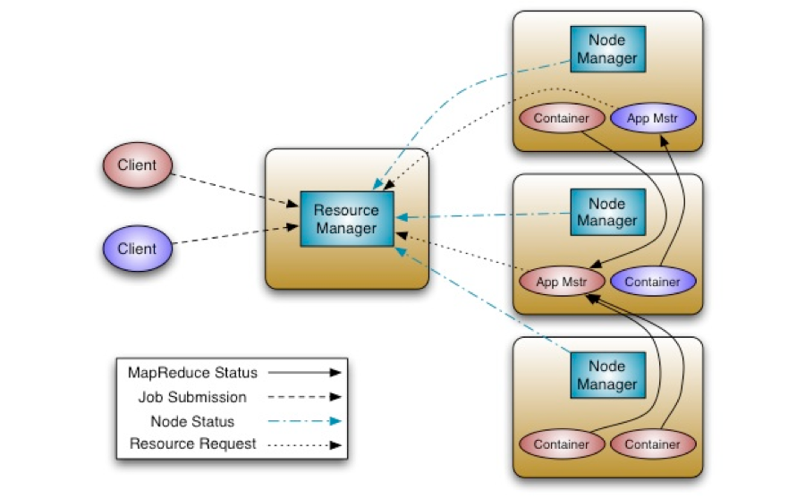
Notes:
http://hortonworks.com/blog/apache-hadoop-yarn-background-and-an-overview/
http://www.slideshare.net/cloudera/introduction-to-yarn-and-mapreduce-2

Slide 14
How to Get Data In?

Slide 15
HDFS & WebHDFS
$ hdfs dfs -put
local_file.csv /user/laseki/test/test.csv
$ curl -i -X PUT "http://namenode:50070/webhdfs/v1/\
user/laseki/test/test.csv?\
user.name=laseki&op=CREATE"
$ curl -i -T webhdfs-test.txt "http://datanode:50075\
/webhdfs/v1/user/laseki/test/test.csv?\
op=CREATE&user.name=laseki&overwrite=false"

Slide 16
Hive
hive > CREATE TABLE user(id INT, name STRING) ROW FORMAT
DELIMITED FIELDS TERMINATED BY ','
LINES TERMINATED BY '\n' STORED AS TEXTFILE;
hive > LOAD DATA INPATH '/user/laseki/test/data1.txt'
INTO TABLE user;
-- -------------------------------------------------------
hive > CREATE EXTERNAL TABLE user(id INT, name STRING)
ROW FORMAT DELIMITED FIELDS TERMINATED BY ','
LINES TERMINATED BY '\n'
STORED AS TEXTFILE
LOCATION '/user/laseki/test';

Slide 17
Sqoop
$ sqoop import \
--connect jdbc:mysql://mysql_server:3306/userdb \
--username user \
--password password \
--table user \
--m 1 \
--where "city =’sec-bad’" \
--target-dir /user/laseki/test
$ sqoop import \
--connect jdbc:mysql://mysql_server:3306/userdb \
--username user \
--password password \
--table user \
--hcatalog-database testdb \
--hcatalog-table user

Slide 18
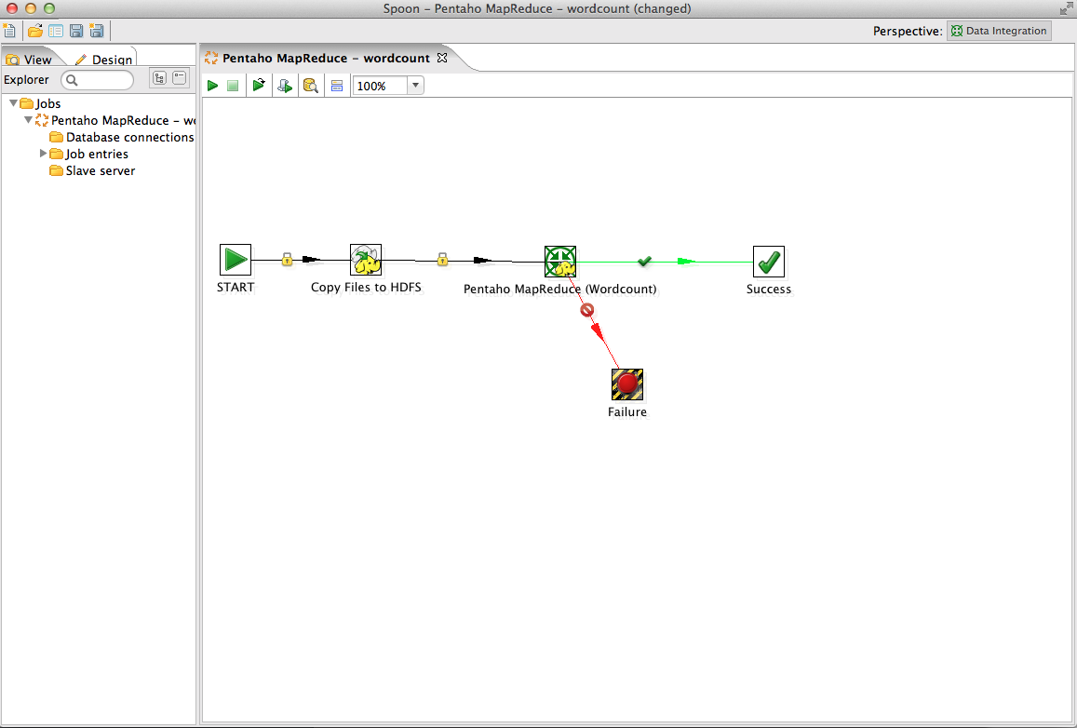

Slide 19
How to Process the Data?

Slide 20
MapReduce – Map
// Hello World Bye World
// Hello Hadoop Goodbye Hadoop
public void map(Object key, Text value, Context context
) throws IOException, InterruptedException {
StringTokenizer itr = new StringTokenizer(value.toString());
while (itr.hasMoreTokens()) {
word.set(itr.nextToken());
context.write(word, one);
}
}
< Hello, 1>
< World, 1>
< Bye, 1>
< World, 1>
< Hello, 1>
< Hadoop, 1>
< Goodbye, 1>
< Hadoop, 1>

Slide 21
MapReduce – Reduce
public void reduce(Text key, Iterable<IntWritable> values,
Context context
) throws IOException, InterruptedException {
int sum = 0;
for (IntWritable val : values) {
sum += val.get();
}
result.set(sum);
context.write(key, result);
}
< Bye, 1>
< Goodbye, 1>
< Hadoop, 2>
< Hello, 2>
< World, 2>

Slide 22

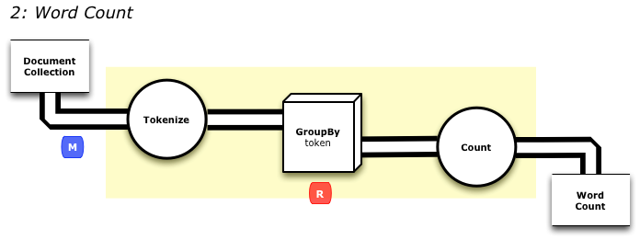
Fields token = new Fields( "token" );
Fields text = new Fields( "text" );
RegexSplitGenerator splitter = new RegexSplitGenerator( token, regex_string );
// only returns "token"
Pipe docPipe = new Each( "token", text, splitter, Fields.RESULTS );
Pipe wcPipe = new Pipe( "wc", docPipe );
wcPipe = new GroupBy( wcPipe, token );
wcPipe = new Every( wcPipe, Fields.ALL, new Count(), Fields.ALL );
FlowDef flowDef = FlowDef.flowDef().setName( "wc" )
.addSource( docPipe, docTap )
.addTailSink( wcPipe, wcTap );

Slide 23

Pig
docPipe = LOAD '$docPath' USING PigStorage('\t', 'tagsource') AS (doc_id, text);
docPipe = FILTER docPipe BY doc_id != 'doc_id';
-- specify a regex operation to split the "document" text lines
-- into a token stream
tokenPipe = FOREACH docPipe GENERATE doc_id,
FLATTEN(TOKENIZE(text, ' [](),.')) AS token;
tokenPipe = FILTER tokenPipe BY token MATCHES '\\w.*';
-- determine the word counts
tokenGroups = GROUP tokenPipe BY token;
wcPipe = FOREACH tokenGroups GENERATE group AS token, COUNT(tokenPipe) AS count;
-- output
STORE wcPipe INTO '$wcPath' using PigStorage('\t', 'tagsource');
EXPLAIN -out dot/wc_pig.dot -dot wcPipe;

Slide 24

SELECT word, COUNT(*)
FROM input LATERAL VIEW
explode(split(text, ' ')) lTable as word GROUP BY word;

Slide 25
How to Present the Data

Slide 26

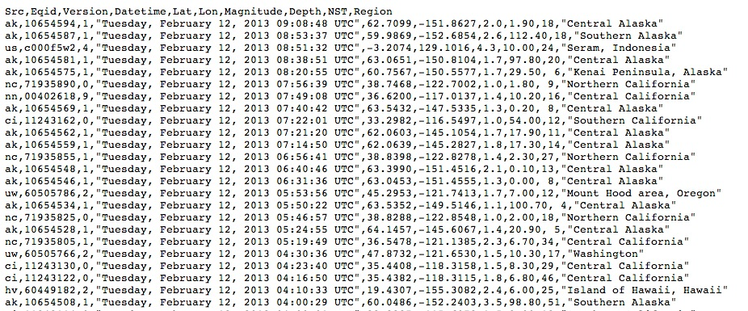

Slide 27
Really?!

Slide 28


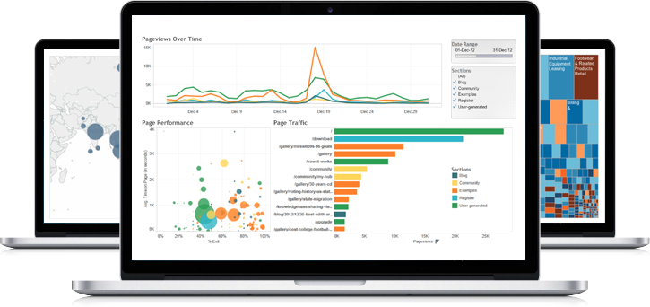

Slide 29



$ bin/hbase shell
hbase(main):001:0> list
hbase(main):002:0> create 'emp', 'personal', ’professional’
hbase(main):003:0> put 'emp',’row1','personal:name','raju’
hbase(main):004:0> put 'emp',’row1','personal:city','hyderabad’
hbase(main):005:0> put 'emp',’row1','professional:designation','manager’
hbase(main):006:0> put 'emp',’row1','professional:salary','50000’
hbase(main):007:0> scan 'emp'
ROW COLUMN + CELL
row1 column = personal:name, timestamp = 1418051555, value = raju
row1 column = personal:city, timestamp = 1418275907, value = Hyderabad
row1 column = professional:designation, timestamp = 14180555,value = manager
row1 column = professional:salary, timestamp = 1418035791555,value = 50000
1 row(s) in 0.0100 seconds
Notes:
http://www.tutorialspoint.com/hbase/index.htm

Slide 30
// Instantiating configuration class
Configuration con = HBaseConfiguration.create();
// Instantiating HbaseAdmin class
HBaseAdmin admin = new HBaseAdmin(con);
// Instantiating table descriptor class
HTableDescriptor tableDescriptor = new
TableDescriptor(TableName.valueOf("emp"));
// Adding column families to table descriptor
tableDescriptor.addFamily(new HColumnDescriptor("personal"));
tableDescriptor.addFamily(new HColumnDescriptor("professional"));
// Execute the table through admin
admin.createTable(tableDescriptor);
System.out.println(" Table created ");

Slide 31


$ curl -XPUT 'http://localhost:9200/web/page/1' -d '
{
"host": "mypage.com",
"lastModDate": "2011-12-15",
"body": "Search is hard. Search should be easy." ,
"title": "On search"
}'
$ curl 'http://localhost:9200/web/page/_search?q=host:mypage.com'

Slide 32
Scheduling

Slide 33

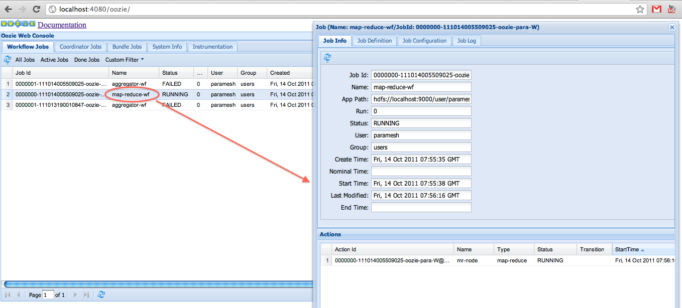
Oozie
Start
Sqoop Ingest
Hive Action
ok
end: success
error
error
kill: fail

Slide 34

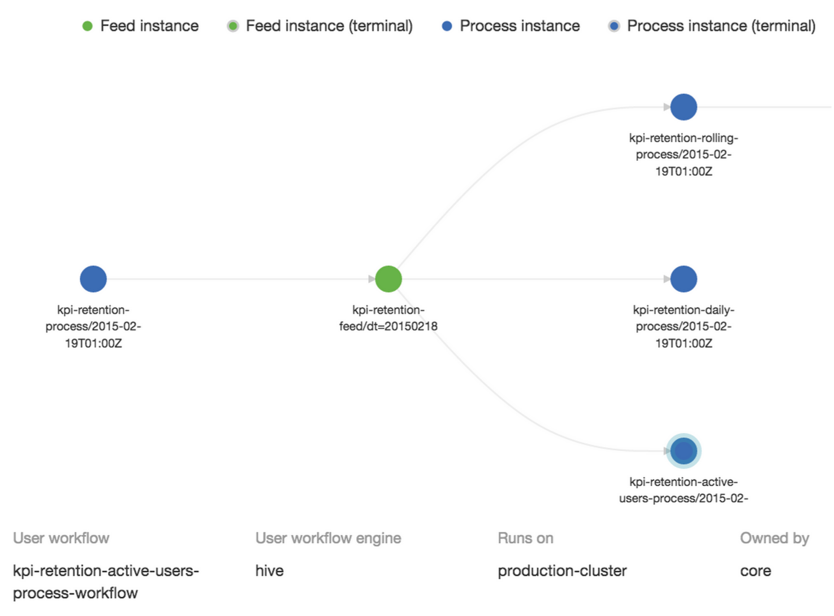

Slide 35
Security

Slide 36
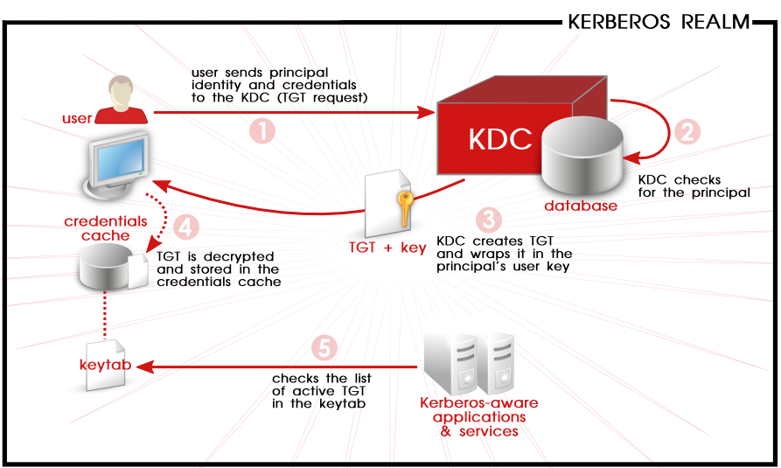
Notes:
https://access.redhat.com/documentation/en-US/Red_Hat_Enterprise_Linux/6/html/Managing_Smart_Cards/Using_Kerberos.html

Slide 37
Manage

Slide 38
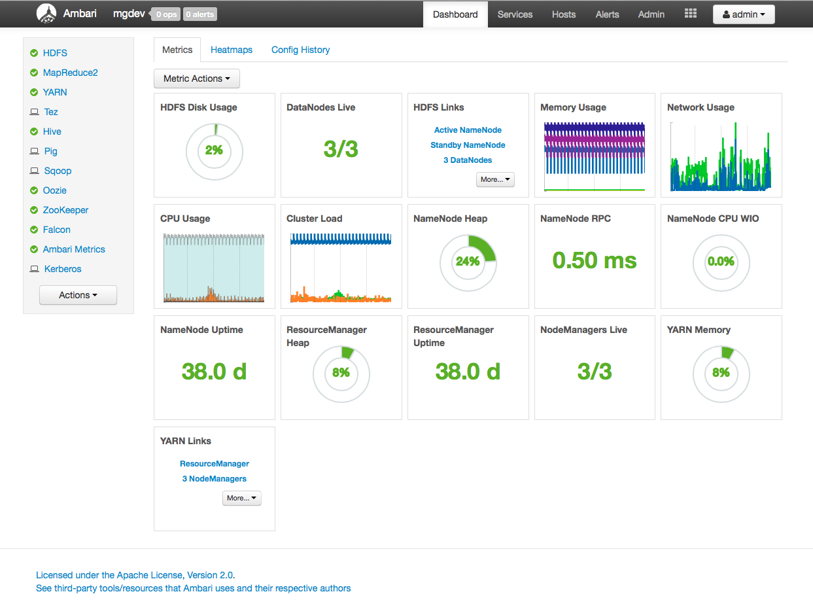

Slide 39
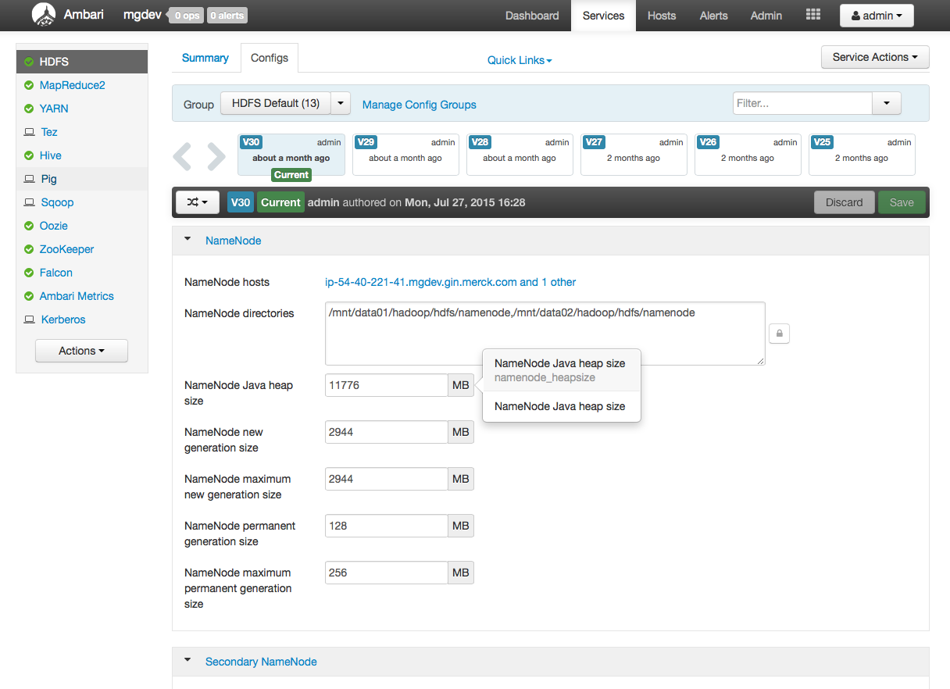

Slide 40
Demo

Slide 41

Buzzwords not Covered
Spark
NoSQL Databases
Stream Processing
Messaging
Machine Learning
Log Aggregation
Lambda Architecture
Notes:
No notes provided.

Slide 42
MSD IT Global Innovation Center in Prague
High performance innovation center established in March 2014
Designed to provide the second speed we require to be an agile, responsive, customer-centric business partner
500 employees (by end of 2015)
Flat, networked, collaboration-based organization
Speed, certainty of Execution
Innovation & Insight
Access to top talent
Notes:
No notes provided.

Slide 43

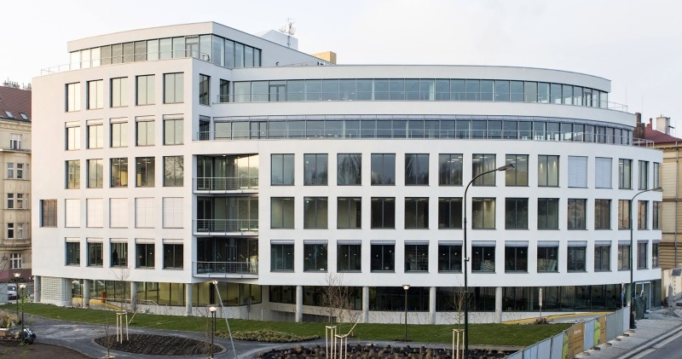
MSD IT Global Innovation Center in Prague
Ivo Lašek:
www.ivolasek.com
@ilasek
ivo.lasek@merck.com
github.com/ilasek
Address:
MSD IT Global Innovation
Center, s.r.o. Riverview Svornosti 3321/2 150 00 Praha 5
www.msdit.cz

